Slide 1

Master‘s thesis montly update
Xiaowei Lin

Slide 2
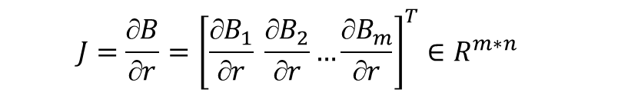
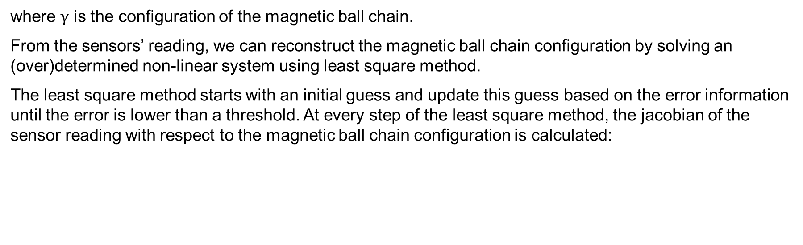
Problem description
Shape sensing of medical continuum robots can be realized magnetic ball chains, which generates shape-specific magnetic field that can be detected by an external array of magnometers. Assuming using $m$ 3-axis magnetometers, the magnetic field measured by the sensor array can be represented as:
$$B\left(γ\right)={\left[B_{1}{\left(γ\right)}^{T} B_{2}{\left(γ\right)}^{T} …B_{m}{\left(γ\right)}^{T}\right]}^{T}∈R^{3m}$$
where $γ$ is the configuration of the magnetic ball chain.
From the sensors’ reading, we can reconstruct the magnetic ball chain configuration by solving an (over)determined non-linear system using least square method.
The least square method starts with an initial guess and update this guess based on the error information until the error is lower than a threshold. At every step of the least square method, the jacobian of the sensor reading with respect to the magnetic ball chain configuration is calculated:
$$ J=\frac{B}{r}={\left[\frac{B_{1}}{r} \frac{B_{2}}{r}…\frac{B_{m}}{r}\right]}^{T}{∈R}^{m∗n}$$
where $n$ is the dimension of the configuration parameters.

Slide 3
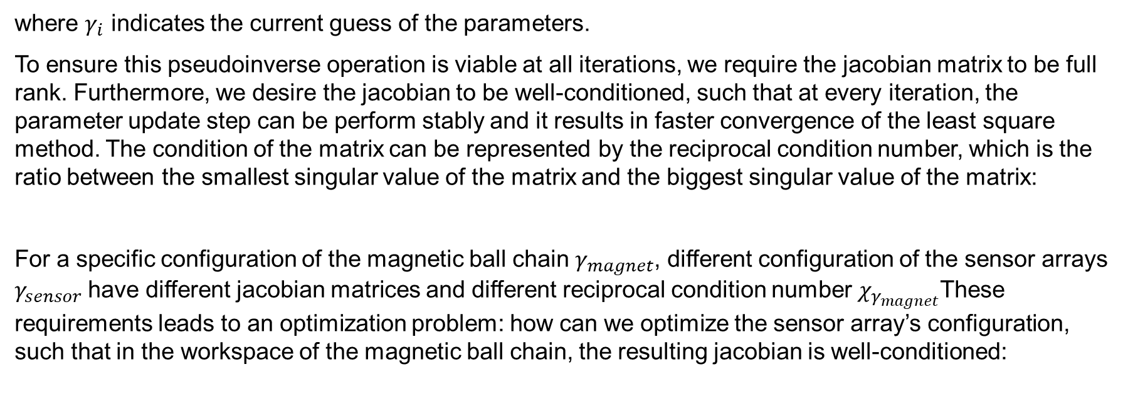

Problem description
And the pseudoinverse of this jacobian is taken to update the guess of the parameters:
$$∆γ=J^{†}(B−B\left(γ_{i}\right))$$
where $γ_{i}$ indicates the current guess of the parameters.
To ensure this pseudoinverse operation is viable at all iterations, we require the jacobian matrix to be full rank. Furthermore, we desire the jacobian to be well-conditioned, such that at every iteration, the parameter update step can be perform stably and it results in faster convergence of the least square method. The condition of the matrix can be represented by the reciprocal condition number, which is the ratio between the smallest singular value of the matrix and the biggest singular value of the matrix:
For a specific configuration of the magnetic ball chain $γ_{magnet}$, different configuration of the sensor arrays $γ_{sensor}$have different jacobian matrices and different reciprocal condition number $χ_{γ_{magnet}}$These requirements leads to an optimization problem: how can we optimize the sensor array’s configuration, such that in the workspace of the magnetic ball chain, the resulting jacobian is well-conditioned:
$$χ=\frac{σ_{min}}{σ_{max}}$$
$${}_{γ_{sensor}}^{max}{ χ_{i} ∀i∈γ_{magnet}}$$

Slide 4
Problem description
Furthermore, we also would like to maximize the signal to noise ratio $SNR$ of each sensor, such that the sensors’ outputs are more reliable. The resulting problem becomes a multi-objective optimization problem:
$${}_{γ_{sensor}}^{max}{{ χ}_{i }, {SNR}_{i} ∀i∈γ_{magnet}}$$

Slide 5
Sensor selection
We first investigate different types of sensor with their specifications. Our requirement is to accurately detect the magnetic field generated by 10 magnetic balls of different diameters in the ball chain at a distance of ..cm (workspace requirement). We put together a list of different sensors and their corresponding capability of sensing the magnetic ball chain of different diameters is indicated. The leftmost column indicates what diameter of the 10 magnetic balls in the chain can be tracked with a signal to noise ratio of >60. The 8th column indicates the sensor’s root mean square noise level at the desired working frequency of ~500 Hz. The colored section indicates the signal to noise ratio. Green section means SNR>60, orange section means 30<SNR<60.
 |  |  |  |  |  |  |  | 10 ⌀ 2.5 mm N42 250 nT | 10 ⌀ 3.175 mm N42 550 nT | 10 ⌀ 4.763 mm N42 1850 nT | 10 ⌀ 6.35 mm N42 4350 nT
2.5mm | Stefan Mayer Instruments FL1-100 | 1-axis | Fluxgate | Analog | 1-4: $430 5-9: $385 | ±100 | 0.5 nT @ 500 Hz | 500 | 1100 | 3700 | 8700
2.5mm | Stefan Mayer Instruments FLC3-70 | 3-axis | Fluxgate | Analog | 1-4: $593 5-9: $563 | ±200 | 1.5 * sqrt(3) nT @ 500 Hz | 167 | 366 | 1234 | 2900
2.5mm | Stefan Mayer Instruments FLC-100 | 1-axis | Fluxgate | Analog | 5-9: $85 | ±100 | 3.4 nT @ 500 Hz | 74 | 161 | 544 | 1280
3/16 inch | PMI RM3100 | 3-axis | Inductive | Digital | $60 ($40 business) | ±800 | 17 * sqrt (3) nT @ 534 Hz | 15 | 33 | 109 | 256
1/4 inch | Texas Instrument DRV425 | 1-axis | Fluxgate | Analog | $24 | ±2000 | 44 nT @ 500 Hz | 6 | 13 | 42 | 99
1/4 inch | Memsic MMC5983MA | 3-axis | Resistive | Digital | $22 | ±800 | 70 nT * sqrt(3) @ 580 Hz | 4 | 8 | 27 | 62

Slide 6
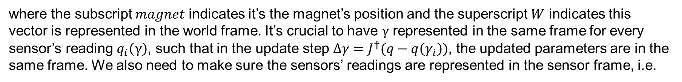
Optimization
We start from the very basic case, where we only consider a single magnet in the work space with its orientation fixed, and construct the optimization problem accordingly. In this case, the magnet configuration parameters are just its position in the workspace:
$$γ=r_{magnet}^{W}={{\left[x, y, z\right]}^{T}}^{W}$$
where the subscript $magnet$ indicates it’s the magnet’s position and the superscript $W$ indicates this vector is represented in the world frame. It’s crucial to have $γ$ represented in the same frame for every sensor’s reading $q_{i}\left(γ\right)$, such that in the update step $∆γ=J^{†}(q−q\left(γ_{i}\right))$, the updated parameters are in the same frame. We also need to make sure the sensors’ readings are represented in the sensor frame, i.e.
$$B_{i}\left(γ\right)=B_{i}^{S_{i}}\left(γ\right)$$
such that the sensors’ orientation information is captured by the sensors’ readings. The overall relationship of sensors’ outputs and magnet configuration becomes:
$$B\left(γ\right)={\left[B_{1}^{S_{1}}\left(r_{magnet}^{W}\right) B_{2}^{S_{2}}\left(r_{magnet}^{W}\right) … B_{m}^{S_{m}}\left(r_{magnet}^{W}\right)\right]}^{T}∈R^{3m}$$

Slide 7
Optimization
The corresponding jacobian for one sensor can be calculated as:
$$\frac{∂B_{i}^{S_{i}}\left(r_{magnet}^{W}\right)}{∂r_{magnet}^{W}}=\frac{∂B_{i}^{S_{i}}}{∂r_{i}^{S_{i}}}\frac{∂r_{i}^{S_{i}}}{∂r_{i}^{w}}\frac{∂r_{i}^{w}}{∂r_{magnet}^{W}}$$
where $r_{i}^{S_{i}}$ is the vector from the magnet position to the sensor $i$’s position, i.e. $r_{i}^{S_{i}}=r_{S_{i}}^{S_{i}}−r_{magnet}^{S_{i}}$, and the $r_{i}^{w}$ is same vector represented in the world frame. This expression of the jacobian is:
$$\frac{∂B_{i}^{S_{i}}\left(r_{magnet}^{W}\right)}{∂r_{magnet}^{W}}=\frac{3μ_{0}}{4π}\frac{\left|μ^{S_{i}}\right|}{{\left|r_{i}^{S_{i}}\right|}^{4}}\left(\left(I−5\hat{r_{i}^{S_{i}}}{\hat{r_{i}^{S_{i}}}}^{T}\right)\left({\hat{r_{i}^{S_{i}}}}^{T}\hat{μ^{S_{i}}}\right)+\hat{μ^{S_{i}}}{\hat{r_{i}^{S_{i}}}}^{T}+\hat{r_{i}^{S_{i}}}{\hat{μ^{S_{i}}}}^{T}\right)∗R_{W}^{S_{i}}∗(−I)$$
where $μ_{0}$ permeability of free space, $μ^{S_{i}}$ is the magnetic dipole moment of the magnet represented in the sensor’s frame, $\hat{μ^{S_{i}}}$ is its corresponding unit vector, $\hat{r_{i}^{S_{i}}}$ is the unit vector for $r_{i}^{S_{i}}$.

Slide 8
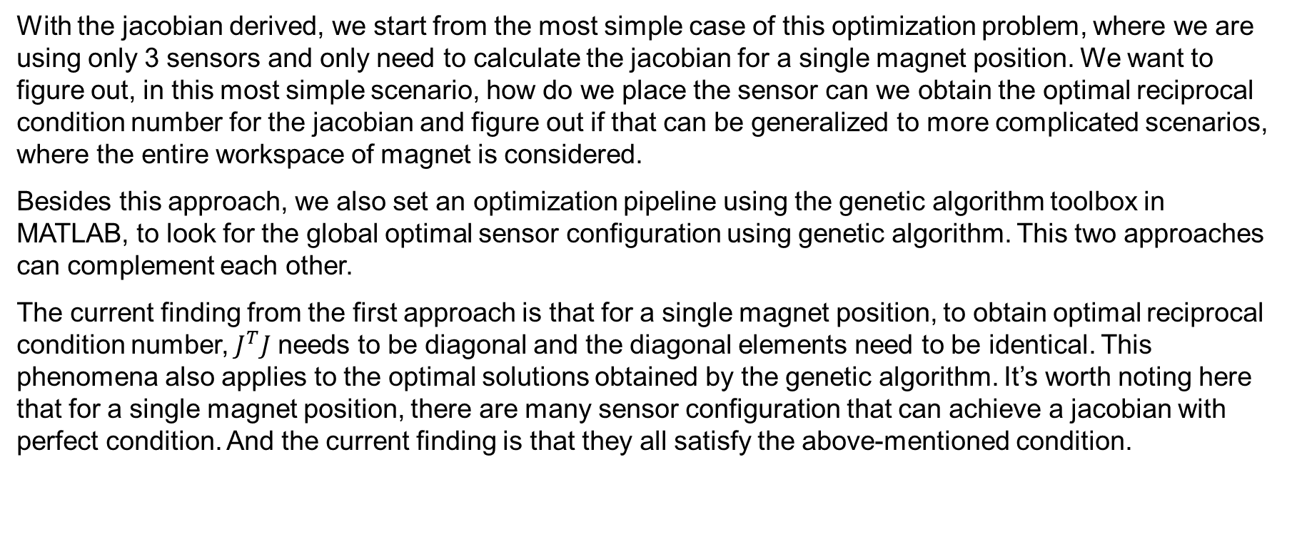
Optimization
With the jacobian derived, we start from the most simple case of this optimization problem, where we are using only 3 sensors and only need to calculate the jacobian for a single magnet position. We want to figure out, in this most simple scenario, how do we place the sensor can we obtain the optimal reciprocal condition number for the jacobian and figure out if that can be generalized to more complicated scenarios, where the entire workspace of magnet is considered.
Besides this approach, we also set an optimization pipeline using the genetic algorithm toolbox in MATLAB, to look for the global optimal sensor configuration using genetic algorithm. This two approaches can complement each other.
The current finding from the first approach is that for a single magnet position, to obtain optimal reciprocal condition number, $J^{T}J$ needs to be diagonal and the diagonal elements need to be identical. This phenomena also applies to the optimal solutions obtained by the genetic algorithm. It’s worth noting here that for a single magnet position, there are many sensor configuration that can achieve a jacobian with perfect condition. And the current finding is that they all satisfy the above-mentioned condition.

Slide 9
Next steps
The latter steps would be to figure out if it’s possible to generalize this finding, if this is viable, the genetic algorithm can be used as a back-up approach. Otherwise, we can still use the genetic algorithm to find the optimal sensor configuration, with the premise that we verify our setup is correct from the simple case where we only consider one magnet position. Then move on to: multiple magnet positions(the entire workspace); adding orientation of the magnet into consideration; adding signal to noise ratio to form a multi objective problem; adding a second magnet to form a constant curvature robot; generalize the magnetic ball chain.

Slide 10
Xiaowei Lin
xiaoweilin@student.ethz.ch
EN 353
Boston Children’s Hospital
300 Longwood Ave,
Boston, MA 02115
USA

